Slide 1
Customer Retention Project

Slide 2
What is Customer Retention?
Customer retention refers to the activities and actions companies and organizations take to reduce the number of customer defections.
Customer satisfaction has emerged as one of the most important factors that guarantee the success of online store; it has been posited as a key stimulant of purchase, repurchase intentions and customer loyalty.

Slide 3
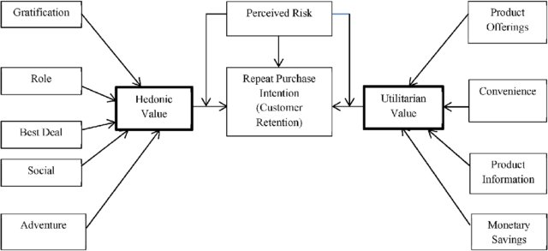
Flow Chart

Slide 4
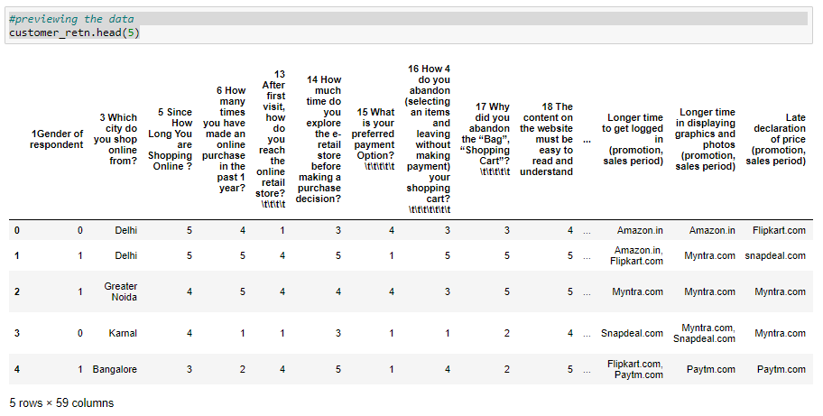
Sample Dataset of online shoppers that results in the e-retail success factors

Slide 5
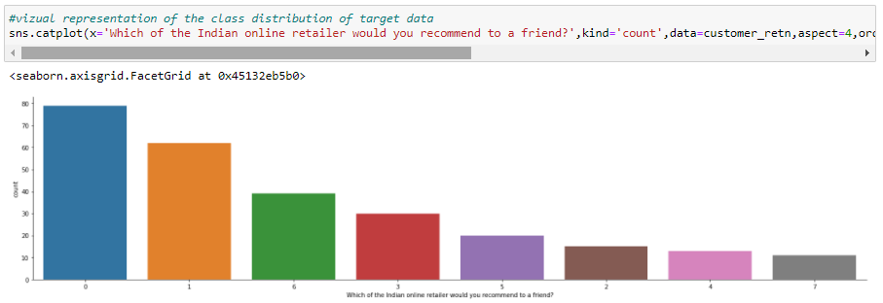
Visualizing the class distribution of the target value

Slide 6
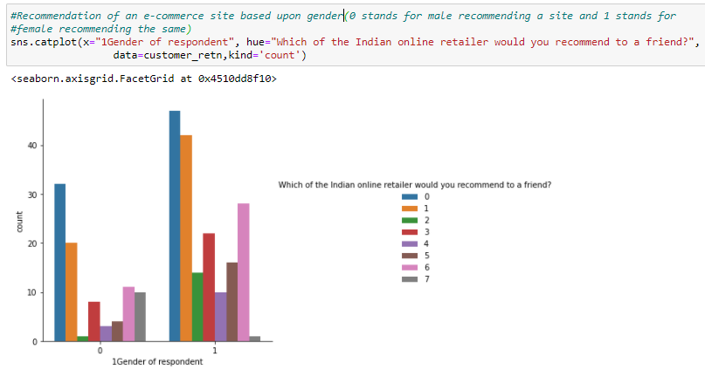
Recommendation of an e-commerce site based upon gender reference

Slide 7
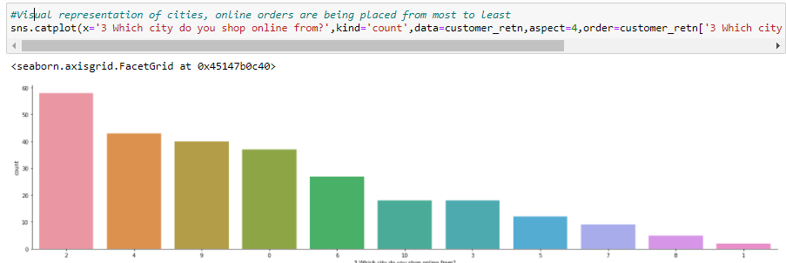
Visual representation of cities, based upon online orders being placed

Slide 8
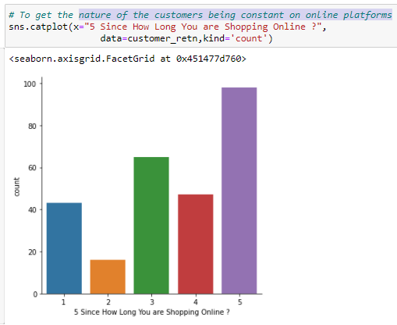
Nature of the customers being constantly shopping on online platforms(in years)

Slide 9
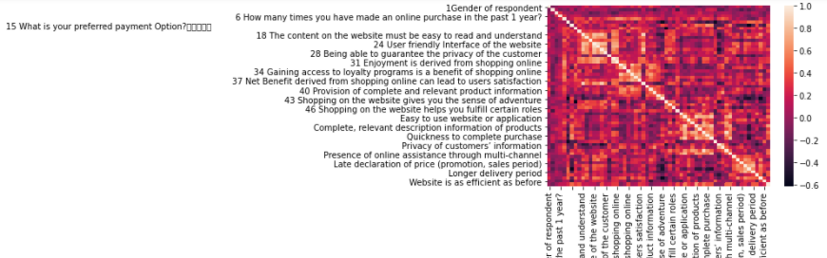
Checking for the interrelation of the columns with each other

Slide 10
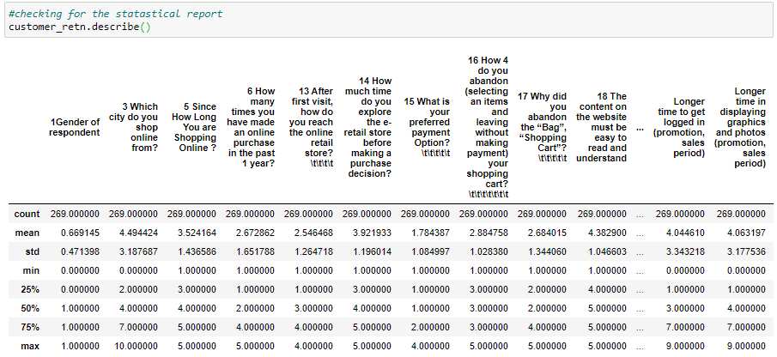
Analysing the statistical report of the Dataset to analyse if there is any outliers present or not by checking the mean, standard deviation and the min and max values, etc.

Slide 11

Separating the independent and dependent variables

Slide 12
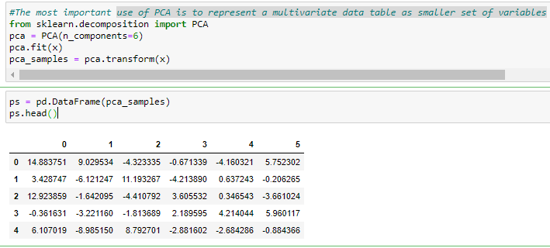
Using PCA is to represent a multivariate data table as smaller set of variables

Slide 13
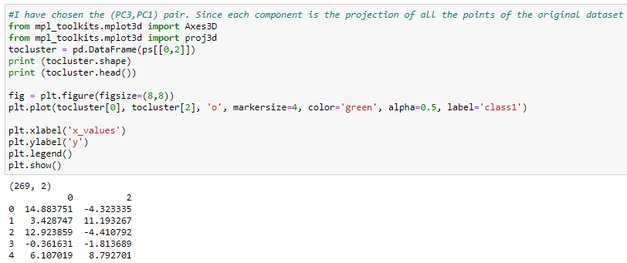

Slide 14
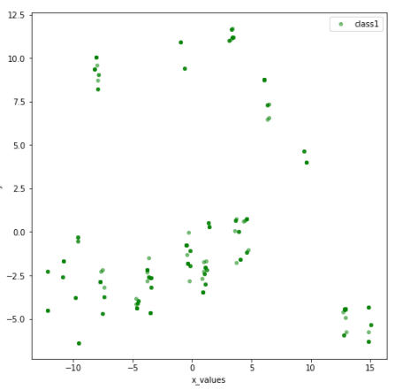
Graphical Representation

Slide 15
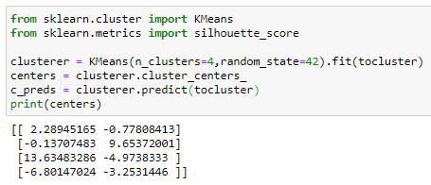
Kmeans algorithm is an iterative algorithm that tries to partition the dataset into Kpre-defined distinct non-overlapping subgroups (clusters) where each data point belongs to only one group.

Slide 16
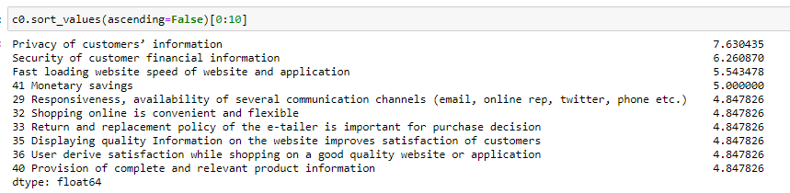
Top 10 features people rely upon of each cluster.

Slide 17
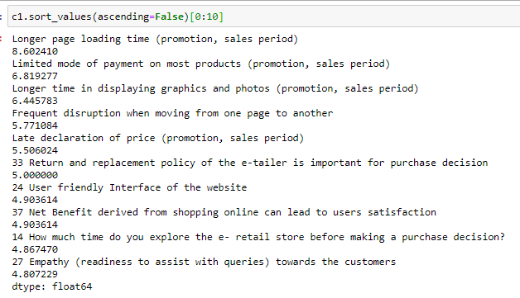

Slide 18
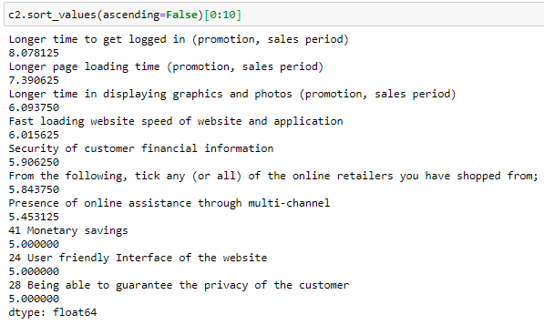

Slide 19
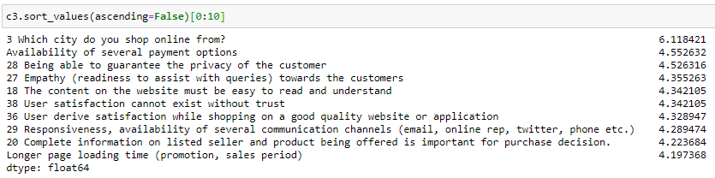
In the same way we can smaller the set of independent variables by selecting top 40-50 features and train the required models to decide upon the retention factor of the customers to get a better score and accuracy.

Slide 20
Thank You

